Slide 1
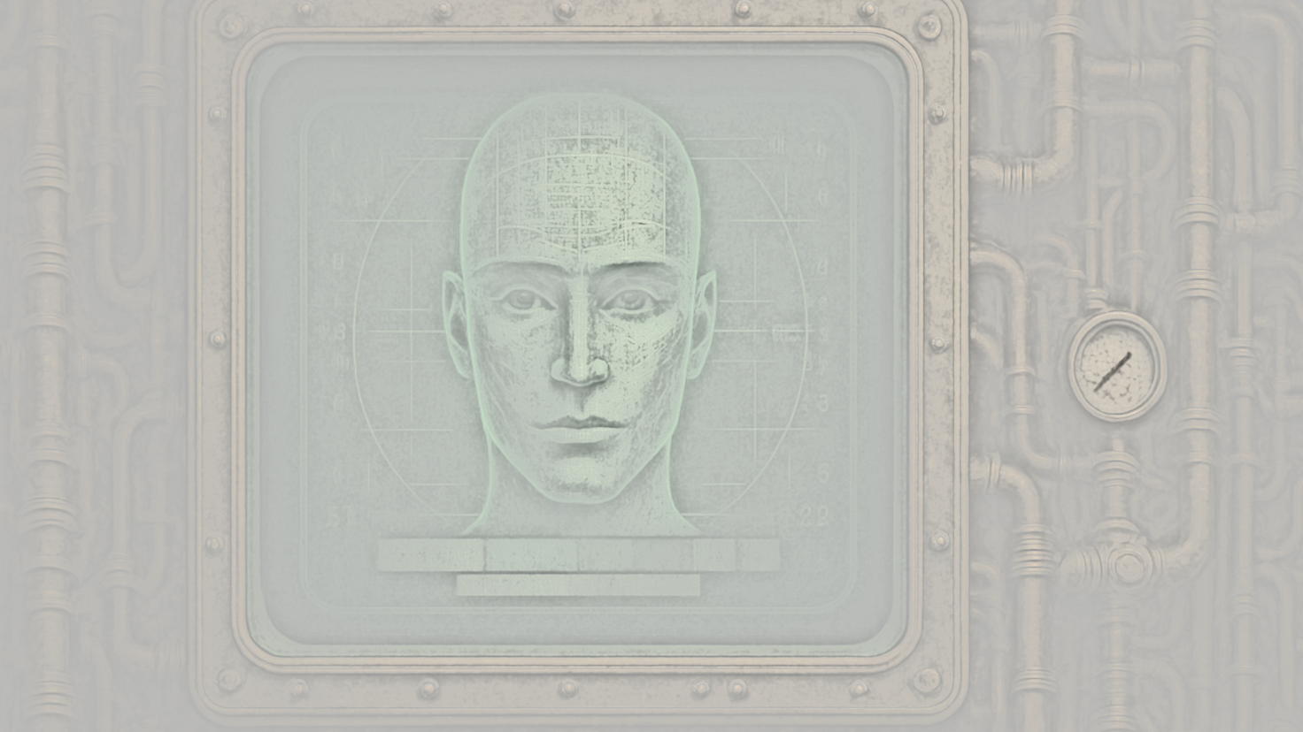
What if your judge could be the computer from Star Trek?
Not cold. Not biased. Just logical, transparent, and incorruptible? Would you waive your right to court?
I would.
Dialogica.io
By DeepTrust Labs

Slide 2
What if your AI could talk to their AI—through a third-party AI that enforces the rules?
A protocol, not a proceeding. Dialogue, not litigation.
Would you waive your right to court? I would.
Dialogica.io
By DeepTrust Labs

Slide 3
What if your dispute was handled by an AI trained not to win—but to be fair? One that balances power, checks bias, and never forgets the rules. Would you waive your right to court?
I would.
Dialogica.io
By DeepTrust Labs

Slide 4
What if your contract could argue its own terms? Not just a document—but a participant, ready to negotiate on your behalf. Would you waive your right to court?
I would.
Dialogica.io
By DeepTrust Labs

Slide 5
What if every step of the negotiation was recorded, signed, and traceable? No secret deals. No vanished emails. Just pure procedural clarity. Would you waive your right to court?
I would.
Dialogica.io
By DeepTrust Labs

